Slide 1







IPHONE PURCHASE PREDICTION USING MACHINE LEARNING
DECISION TREE CLASSIFIER
Get Started

Slide 2

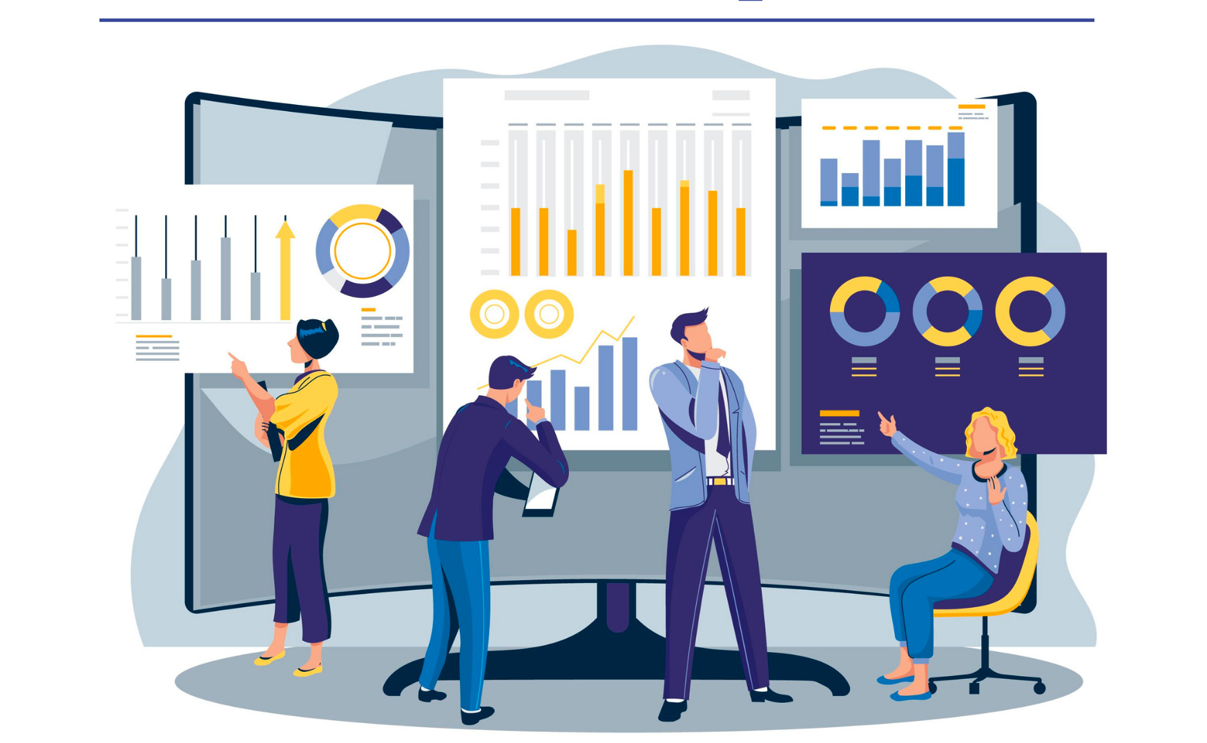
01.
02.
03.
Objectives
Solution
Business Impact
content.
Table of

Slide 3


Objectives
The objective of this project is to predict iPhone purchases based on age, gender and salary using the Decision Tree Classifier.

Slide 4
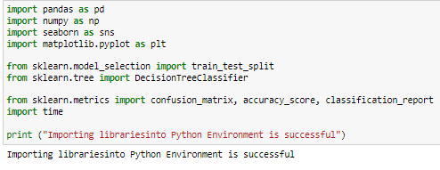
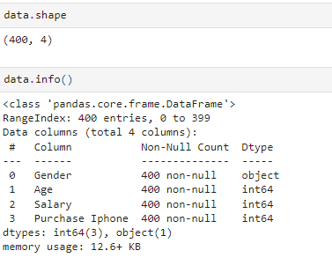
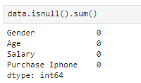
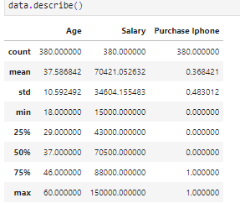
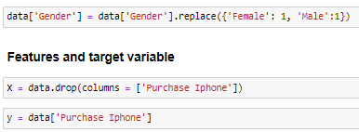
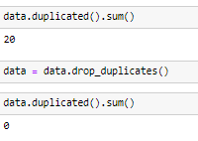
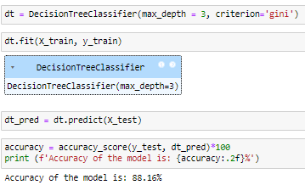
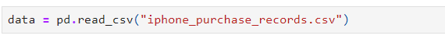
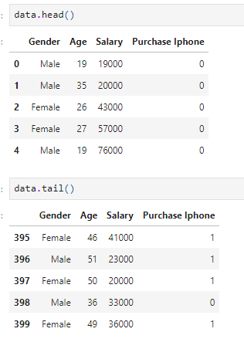
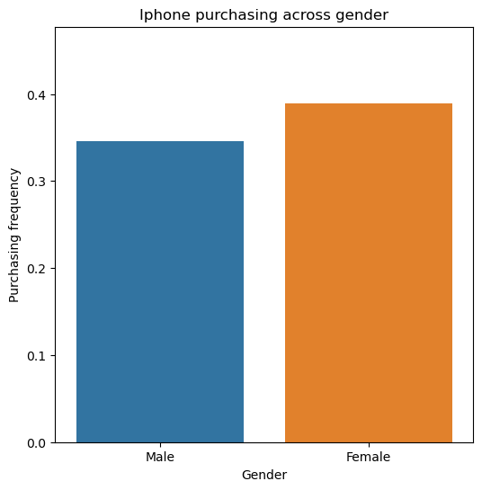
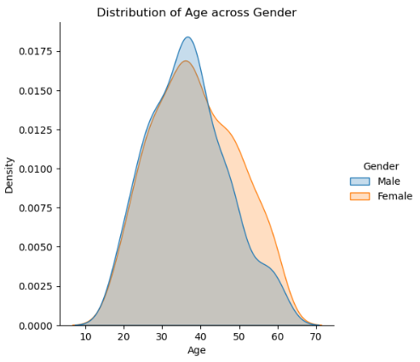
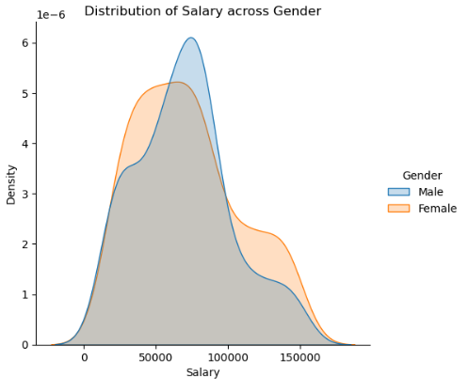
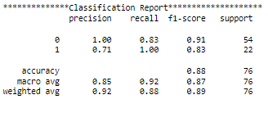
Solution
Libraries importing
Data Loading
Data Exploration
Data Preprocessing
EDA
Model development

Slide 5



Prediction of iPhone purchasing intention of customers
Evaluation of iPhone purchasing frequency across Gender
Business Impact
Estimation of influence of Salary on iPhone purchasing behavior of customers

Slide 6

Thank
You.

